Slide 1
HMH Science Dimensions
Biology
Unit 5: Cells: Stability and Change
Lesson 1: The Cell Cycle
Notes:
The learning experiences in this unit prepare students for the mastery of
Performance Expectations
LS1-4 Use a model to illustrate the role of cellular division (mitosis) and differentiation in producing and maintaining complex organisms.

Slide 2

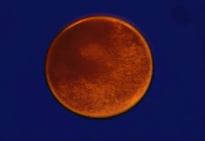
Can You Explain It?
Unit 5 Lesson 1
Observe how a frog develops from a single cell.
Notes:
Lesson Objective
To explain how scientists study Earth’s systems, including system components, scale, and dynamics, and how scientists use evidence and patterns to make predictions about system behavior over time.

Slide 3

Can You Explain It?
Unit 5 Lesson 1
Why aren't all organisms made of just one cell?
Why do cells divide, instead of simply growing larger?
Notes:
Lesson Objective
Use a model to illustrate the role of the cell cycle in producing and maintaining complex organisms.

Slide 4
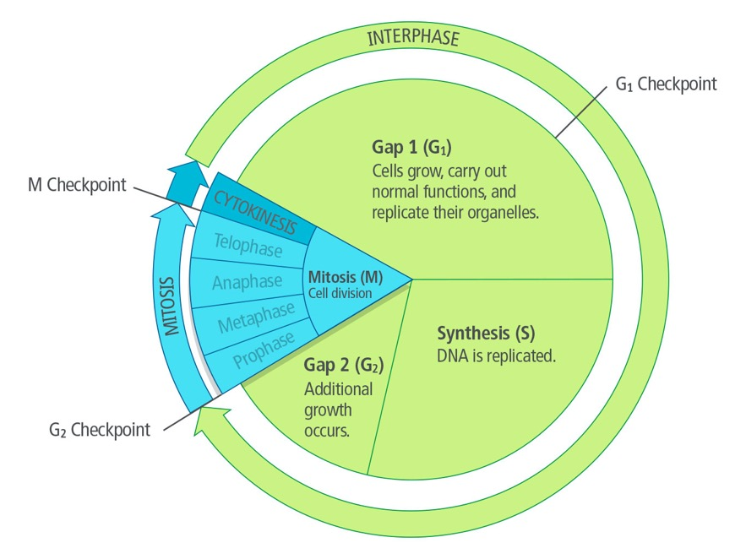
The Stages of the Cell Cycle
Unit 5 Lesson 1
The cell cycle is the regular pattern of growth, DNA duplication, and cell division that occurs in eukaryotic cells, or cells with nuclei.
Which phase of the cell cycle do cells spend most time in?

Slide 5
The Stages of the Cell Cycle
Unit 5 Lesson 1
Cell Cycle Checkpoints keep cells from moving to the next stage before certain conditions are met.
During G₁, the cell must pass a critical checkpoint before it can proceed to the synthesis stage. This ensures that DNA is relatively undamaged and can be properly replicated.
G₂ has its own critical checkpoint. Everything must be in order—adequate cell size, DNA correctly replicated—before the cell goes through mitosis and division.
COLLABORATE
If a cell has damaged DNA, what do you think happens during the G₂ checkpoint?

Slide 6
The Stages of the Cell Cycle
Unit 5 Lesson 1
Different Cells Divide at Different Rates
Cell Type | Approximate Life Span
Skin cell | 2–3 weeks
Red blood cell | 4 months
Liver cell | 10–18 months
Intestine—internal lining | 4–5 days
Intestine—muscle and other tissues | 16 years
ANALYZE
Why does a skin cell need to divide more frequently than a liver cell?

Slide 7
The Stages of the Cell Cycle Math Connection
Unit 5 Lesson 1
Cell Type | Approximate Life Span
Skin cell | 2–3 weeks
Red blood cell | 4 months
Liver cell | 10–18 months
Intestine—internal lining | 4–5 days
Intestine—muscle and other tissues | 16 years
There are about 25 trillion red blood cells in the human body.
Use the data from the table to calculate the number of red blood cells the human body loses due to natural cell death each second. Assume there are 30 days in 1 month. Convert your answers to decimal form and round to the nearest tenths place (e.g., 1,000,000 = 1 million).

Slide 8
Unit 5 Lesson 1
The Stages of the Cell Cycle
Cells that divide rarely are thought to enter a gap phase called G₀.
Some cells, such as neurons, may remain in G₀ permanently.
EXPLAIN
Make a claim for how the cell cycle relates to the growth and maintenance of organisms.
Discuss the stages of the cell cycle, mechanisms that regulate it, and how this cycle is related to the growth and maintenance of organisms.

Slide 9
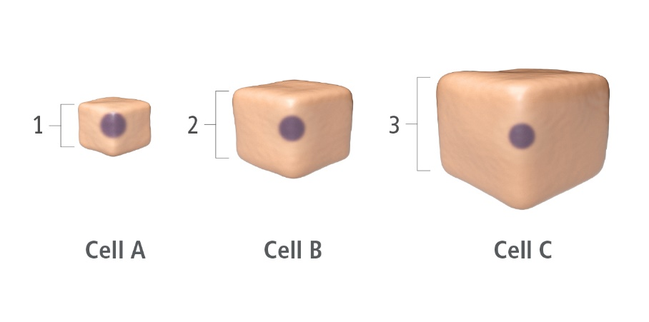
Unit 5 Lesson 1
Factors Affecting Cell Growth
Calculating Cell Size
To Calculate the surface area-to-volume ratio for Cell A:
1. Surface area = length × width × number of sides = 1 × 1 × 6 = 6
Volume = length × width × height = 1 × 1 × 1 = 1
Surface area-to-volume ratio = 6:1

Slide 10
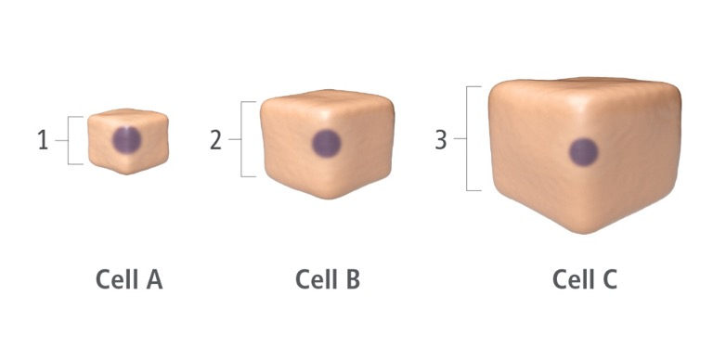
Unit 5 Lesson 1
Factors Affecting Cell Growth
Calculating Cell Size
Calculate the surface area and volume for Cell B and Cell C.
What is the surface area-to-volume ratio for each cell?
EXPLAIN
Describe the pattern you observe in the surface area-to-volume ratios as the cell gets larger.

Slide 11
Factors Affecting Cell Growth
Unit 5 Lesson 1
No matter how materials move across the membrane, they must be transported in adequate amounts and with adequate speed to maintain homeostasis.
To maintain a suitable cell size, growth and division must be coordinated.
Make a claim for why cells must stay within a certain size range in order to maintain homeostasis.
Explain how surface area and volume are related to this phenomenon.

Slide 12

Factors Affecting Cell Growth Hands-On Lab: Modeling Cell Surface Area-to Volume Ratio
Unit 5 Lesson 1
Use model cells to investigate how a cell's size affects its ability to transport materials across the membrane and maintain homeostasis.

Slide 13
Unit 5 Lesson 1
Factors Affecting Cell Growth
Regulating Cell Division - both internal and external factors work together to control when and how often a cell divides.
Internal factors come from inside the cell and include several types of molecules found in the cytoplasm.
External factors come from outside the cell, either from nearby cells or from another part of the organism's body.
MODEL
Create a graphic organizer to describe the different factors that influence cell division. Include information related to the cell cycle, rates of cell division, cell size, and internal and external factors.

Slide 14
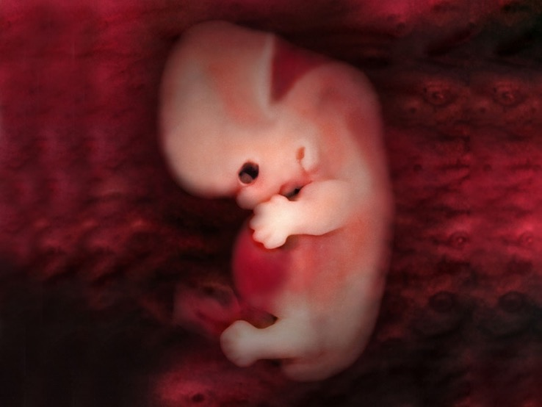
Unit 5 Lesson 1
Factors Affecting Cell Growth
Programmed cell death is known as apoptosis, and it occurs when internal or external signals activate genes that help produce self-destructive enzymes.
In early stages of development, human embryos have webbing between their fingers and toes.

Slide 15
Unit 5 Lesson 1
Factors Affecting Cell Growth
COLLABORATE
Human embryos have webbed digits (fingers and toes) early in their development. The cells between the digits undergo apoptosis during later stages of development. With a partner, draw a model to show how apoptosis leads to changes in the structure of digits during later stages of development.

Slide 16
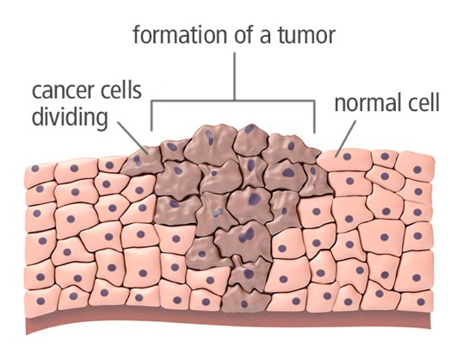
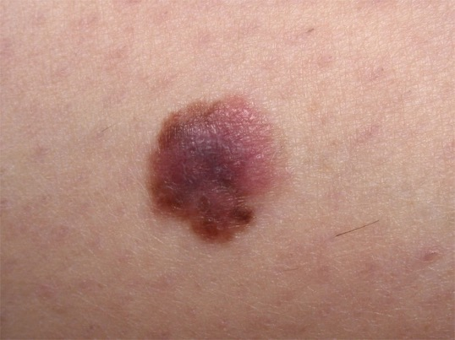
Unit 5 Lesson 1
Factors Affecting Cell Growth
Normal animal cells respond to external factors and stop dividing when they touch each other. Cancer cells fail to respond to these factors. The cancerous growth shown here is a form of skin cancer called melanoma.
Describe the differences in the normal cells and the cancerous cells shown.

Slide 17
Unit 5 Lesson 1
Factors Affecting Cell Growth
ANALYZE
A sensory neuron serving the toe of a giraffe has an average length of nearly 4.6 meters. Use what you have learned about cell surface area and volume to explain how this cell can function properly.

Slide 18
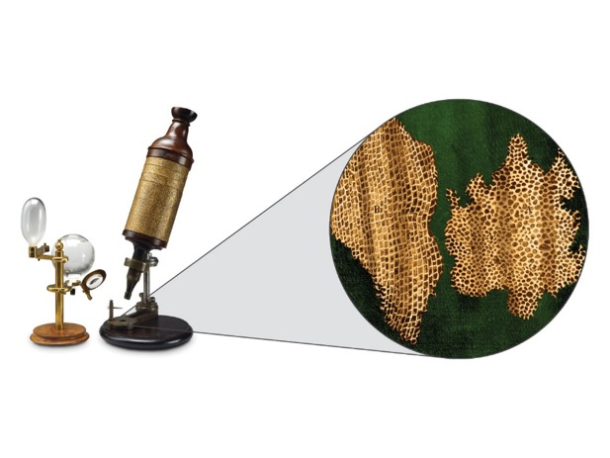
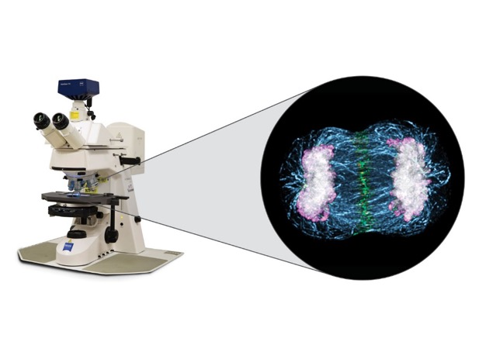
Unit 5 Lesson 1
A Brief History of Cell Theory
The cells viewed under Hooke's microscope are from cork, dead plant tissue.
The cell viewed under the modern microscope is in the process of dividing.
Advances in which fields most likely influenced changes in microscope technology?

Slide 19
Unit 5 Lesson 1
A Brief History of Cell Theory
The cell theory is one of the first unifying concepts developed in biology.
Major principles of the cell theory:
All organisms are made of cells
All existing cells are produced by other living cells.
The cell is the most basic unit of life
Using the development of cell theory as an example, make a claim for how science influences technology and how technology influences science.
Cell theory changed over time as new discoveries came to light. What does this say about a scientific theory?

Slide 20
Unit 5 Lesson 1
A Brief History of Cell Theory
EXPLAIN
Before the cell theory was developed, many people claimed that spontaneous generation was possible. In other words, that cells arose from nonliving matter, such as dust or rotting meat. Respond to that claim using the principles of cell theory.

Slide 21
Unit 5 Lesson 1
Continue Your Exploration
Choose one of the paths below to continue your exploration:
Modeling Cell Surface Area-to-Volume Ratio
Viruses: Measuring Cell Division
Cell Biologist: Cancer Research

Slide 22
Can You Explain It?
Unit 5 Lesson 1
Refer to the notes in your Evidence Notebook to construct an explanation for why cells divide instead of simply growing larger. In your explanation, address the following questions:
1. How are the cell cycle and cell division related to the growth, development, and maintenance of the organism?
2. How do different factors influence cell growth and cell division?
3. How has technology influenced our understanding of cells and cell division?

Slide 23
Image Credits
Unit 5 Lesson 1
busy crosswalk ©Robert Harding/Wendy Connett/Getty Images; herd of deer ©Tim Graham/Alamy; school of fish ©Rich Carey/Shutterstock; gannet colony ©Moment/Stoneography/Getty Images; sloth ©Vilainecrevette/Shutterstock; group of elephants ©Michael Potter11/Shutterstock; wolves stalking moose ©Rolf O. Peterson; wolves stalking moose ©Rolf O. Peterson; Hooke's compound microscope ©Photo by SSPL/Getty Images; Hooke's sketches of cork cells ©Omikron/Science Source; fluorescent microscope ©Ted Kinsman/Science Source; telophase of mitosis ©University of Dundee/Dr. Paul Andrews/Science Source; melanoma ©Girand/Science Source; tadpole egg cells dividing video ©Cytographics Pty Ltd./Image Bank Film/Getty Images; human embryo ©Anatomical Travelogue/Science Source

